Slide 1

FoodieHub
Radhashree Bose

Slide 2

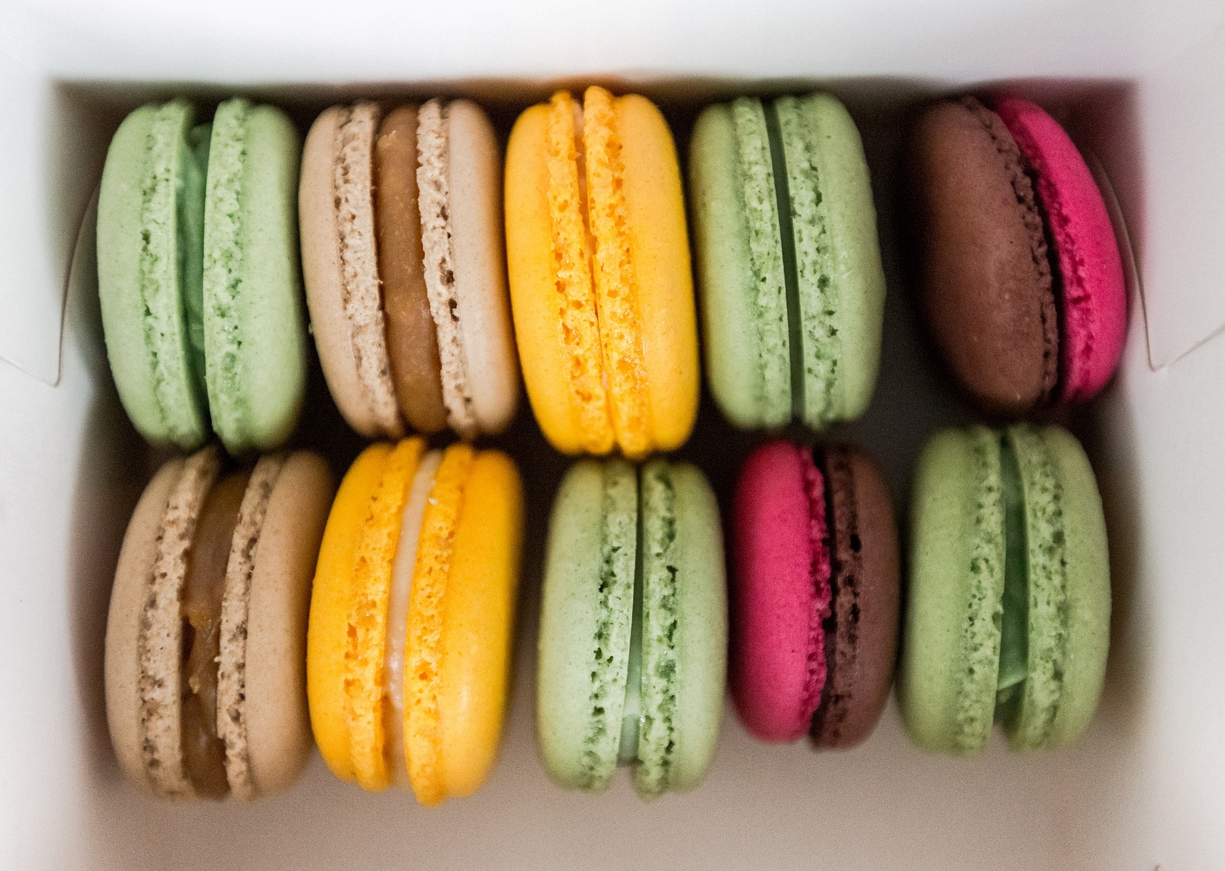
Introduction
FoodieHub is a web application aimed towards food enthusiasts, allowing users to discover and review restaurants, create food blogs, and share their culinary experiences. The platform offers features such as user authentication and profiles, restaurant listings, detailed restaurant information, a review and rating system, food blogging capabilities, user comment sections, customized user settings and an admin panel. Users can browse restaurants, access restaurant menus, and read reviews from others. Ultimately, FoodieHub promotes exploration and discussion of various cuisines and culinary experiences.

Slide 3
Objectives
To provide a comprehensive platform that allows users to discover new restaurants based on their specific criteria and preferences.
To promote genuine and reliable reviews by allowing users to provide honest feedback on their dining experiences.
To provide an interactive platform where users can engage in discussions about various cuisines and share their culinary experiences.
To encourage food enthusiasts to share their knowledge and experiences by creating personalized food blogs.
To foster a community of like-minded food enthusiasts who can benefit from each other's experiences and recommendations.
To provide an intuitive user interface that is easy to navigate and use, ensuring an enjoyable user experience for everyone.
To continuously improve the platform by incorporating user feedback and suggestions.

Slide 4
Tech Stack:
HTML
CSS
PYTHON FLASK
MONGODB
PYMONGO

Slide 5

Functionalities

Slide 6
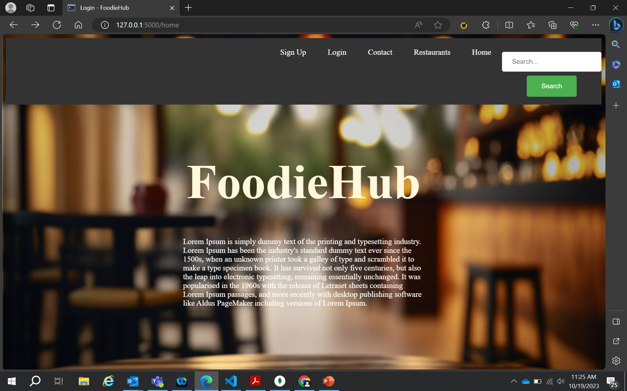
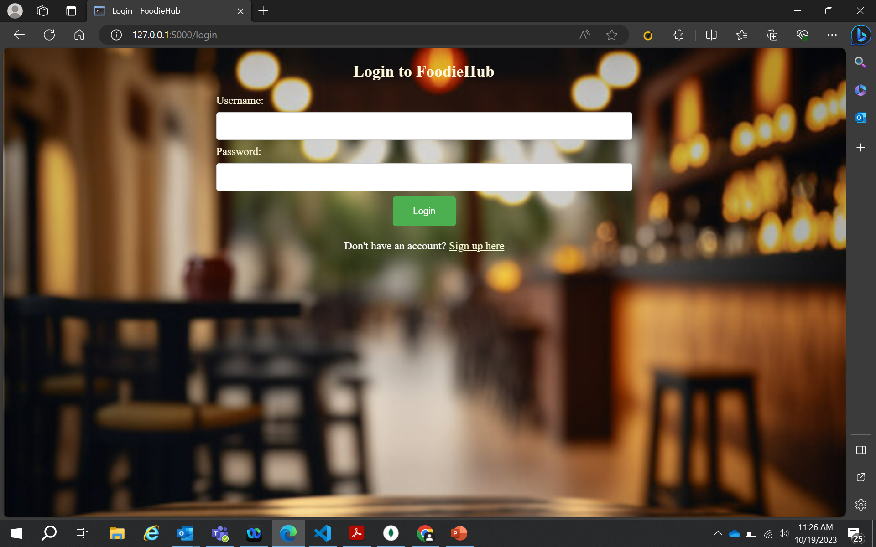
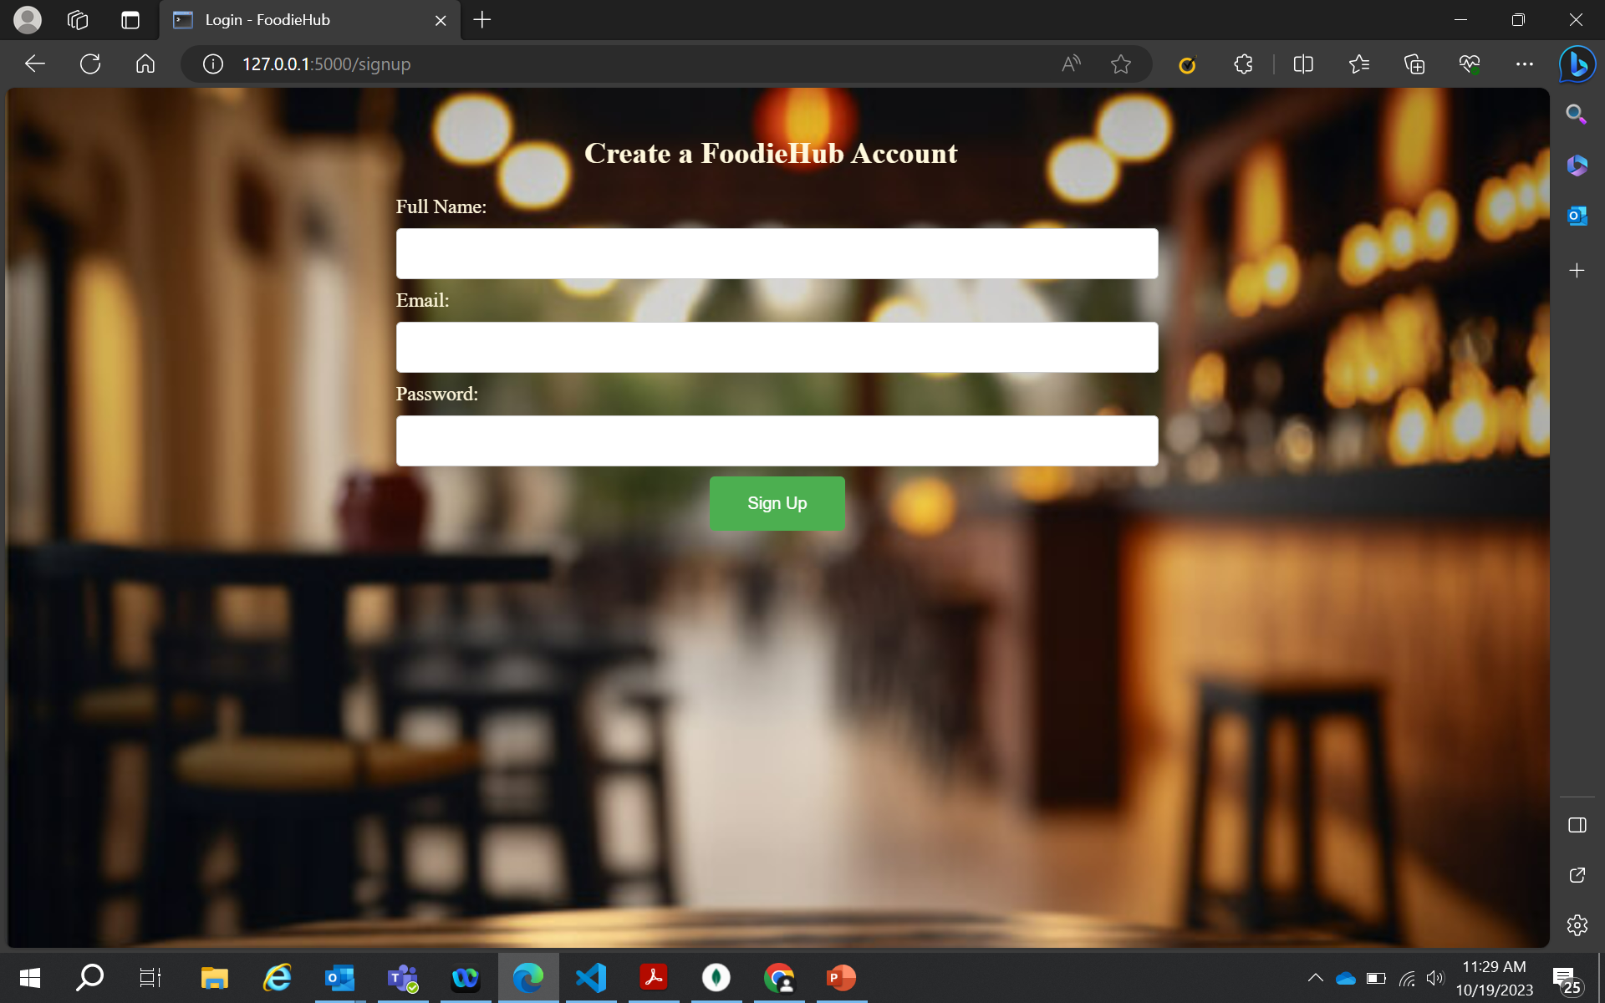
Home and Login/SignUp
HOME PAGE
Login Page
SignUp Page

Slide 7
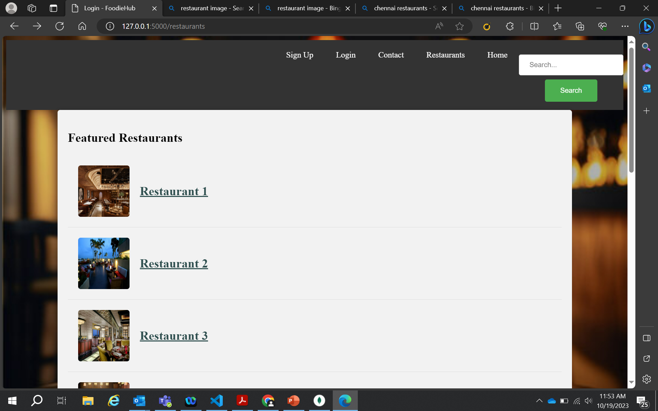
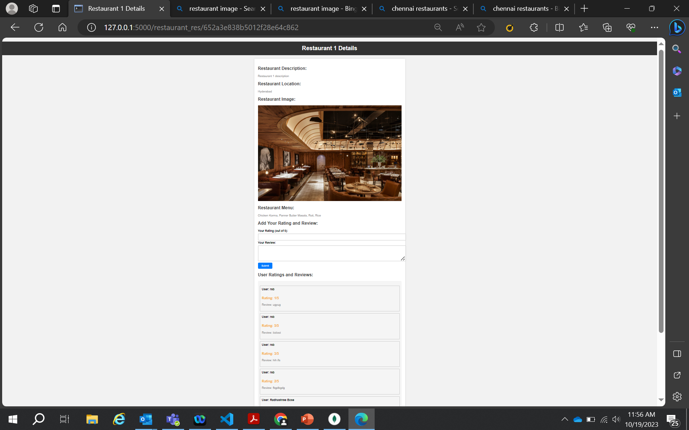
List of Featured Restaurants
Restaurant Page

Slide 8
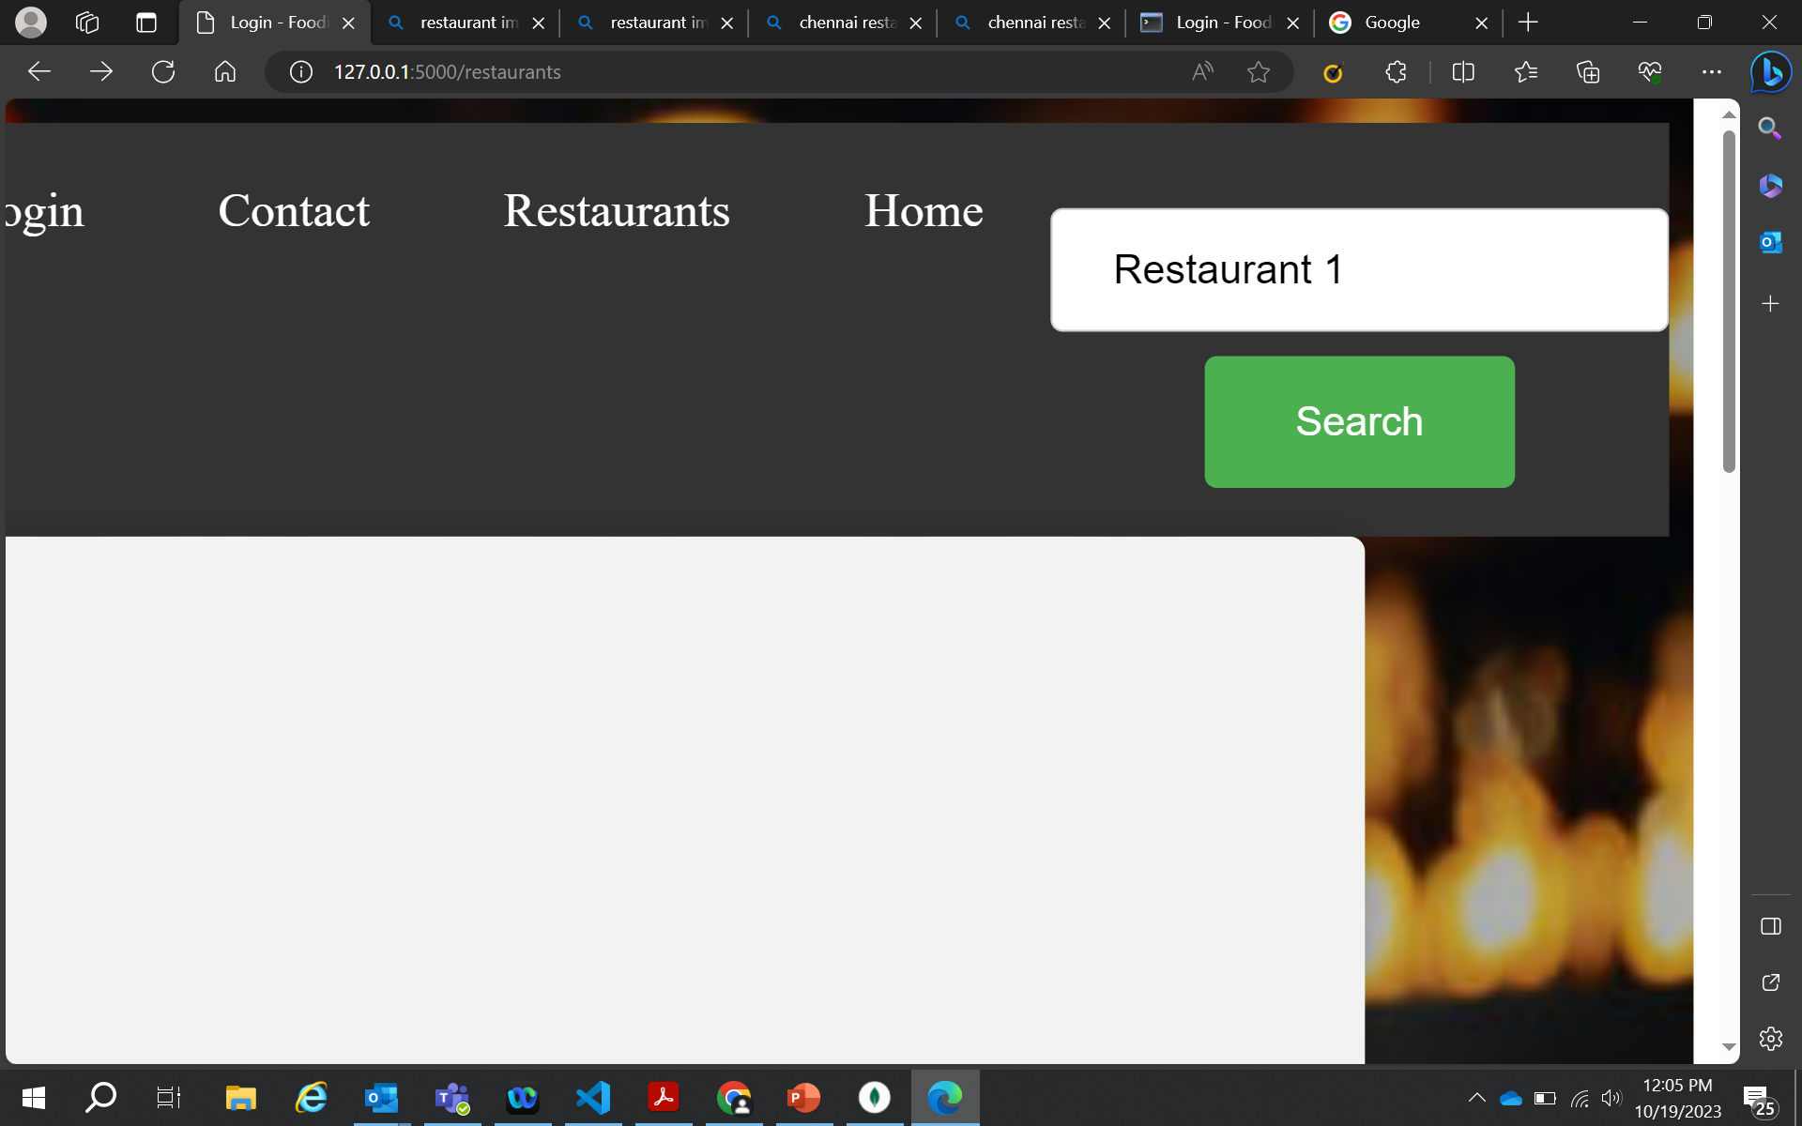

Search Bar:
To search Restaurants and Users

Slide 9
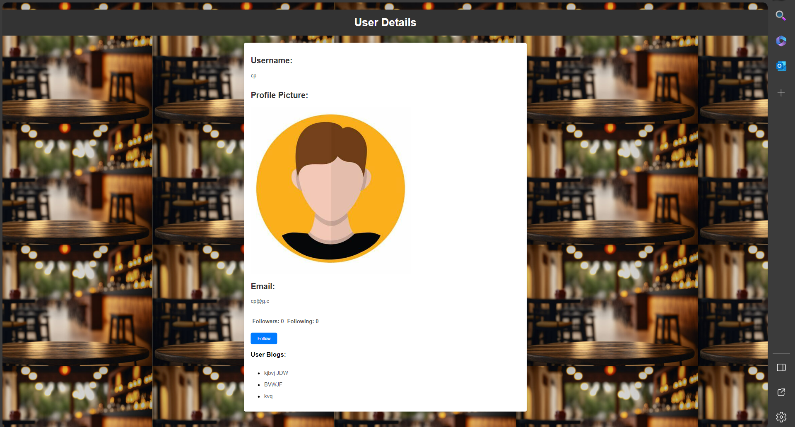
Other User’s Profile Page with Follow/Unfollow Button, their profile details and their food blogs

Slide 10
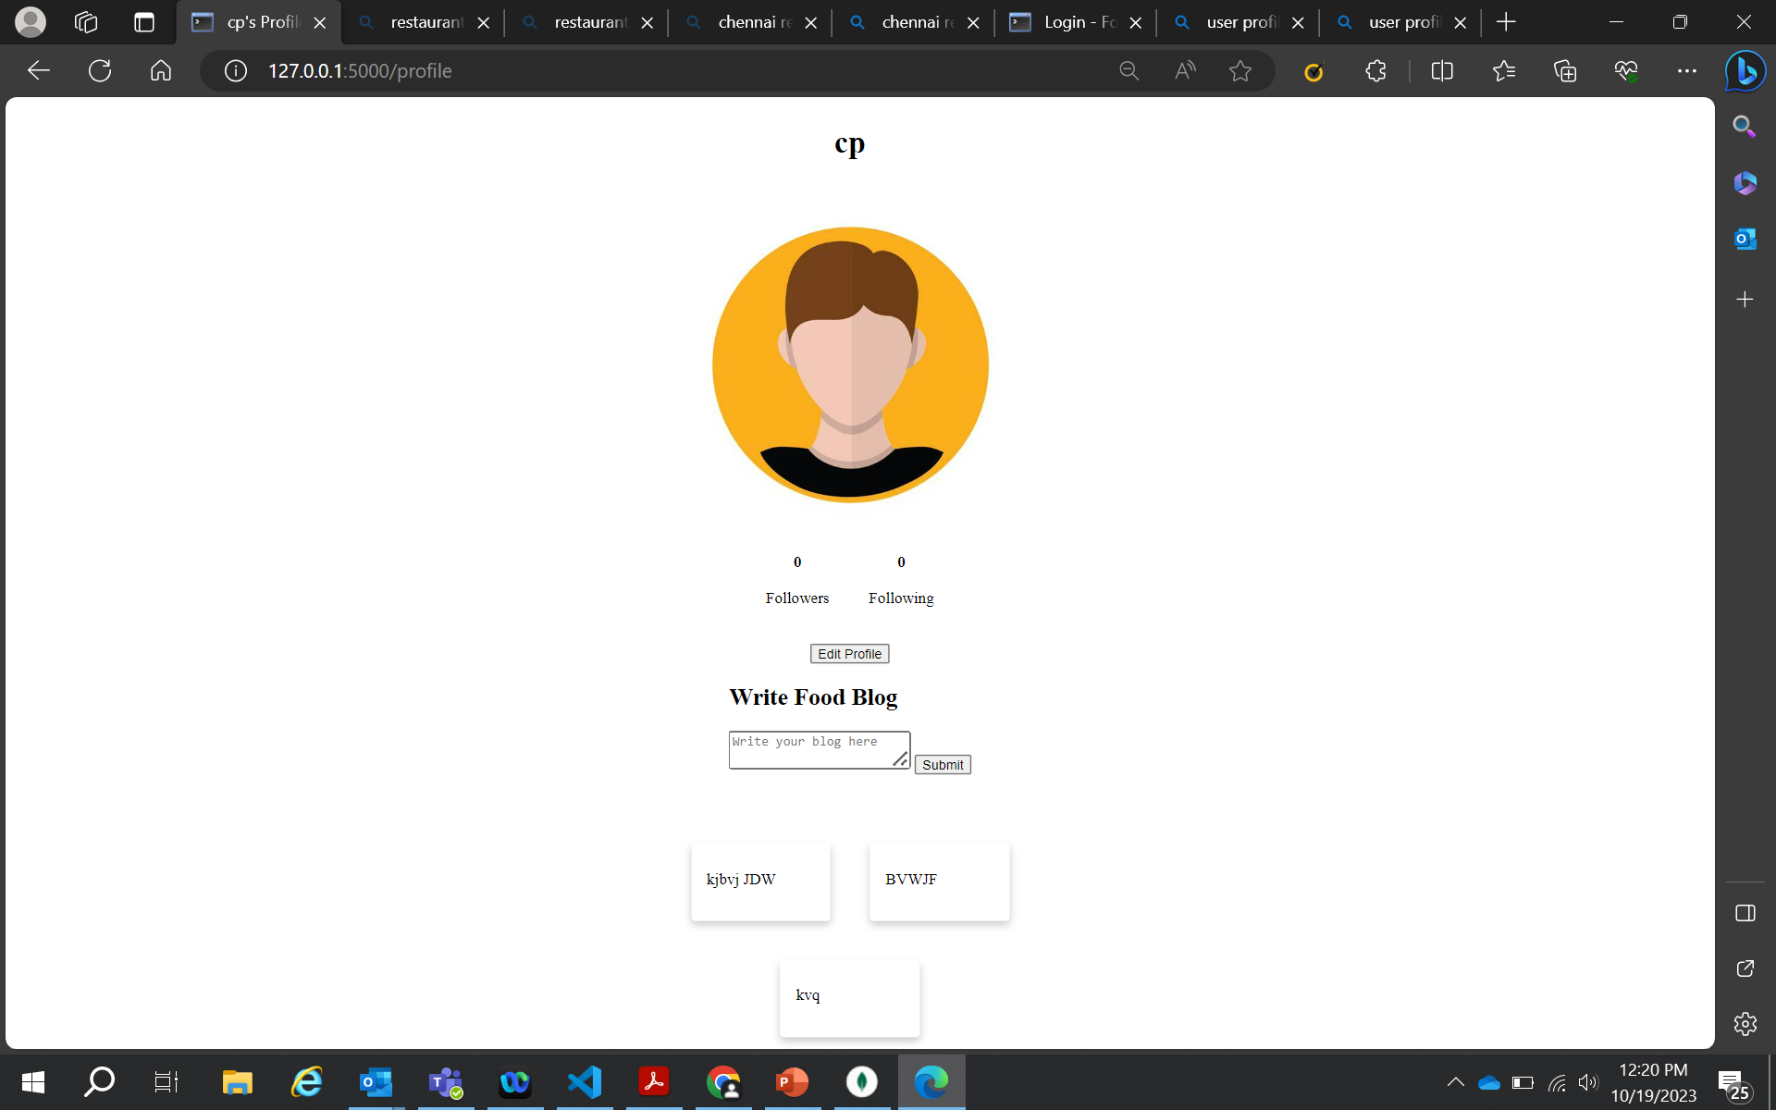
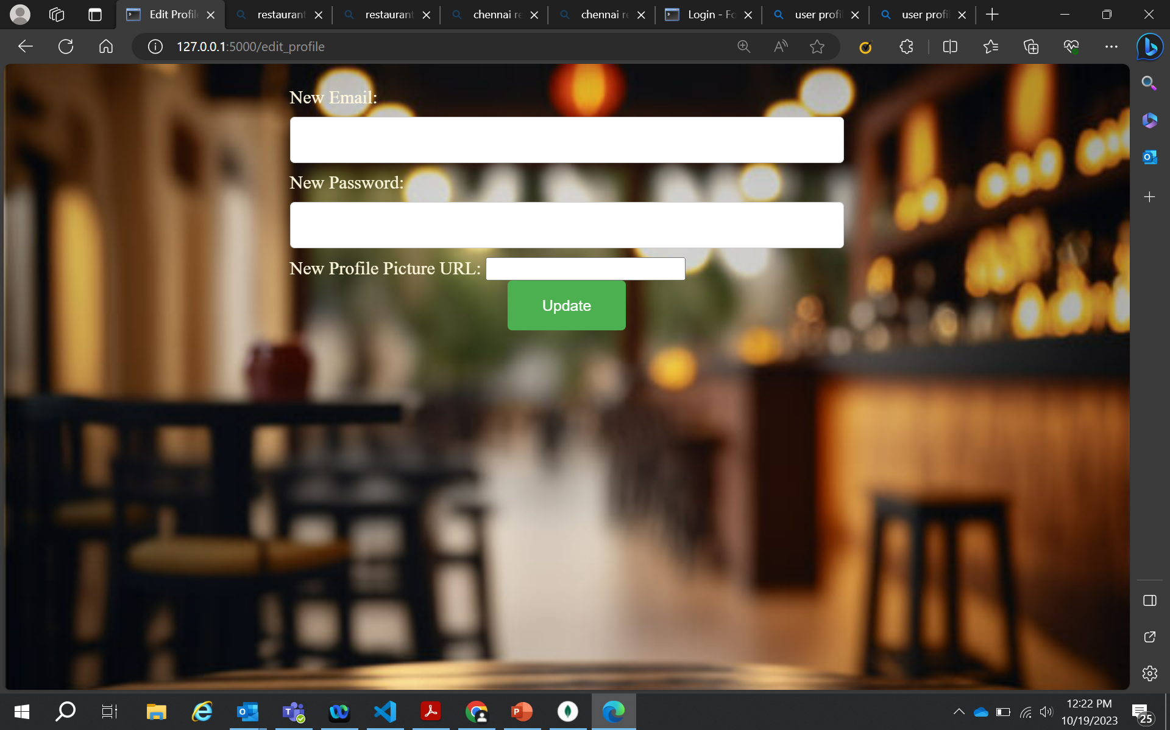
User’s Own Profile with past blogs and edit option
Edit Profile Page

Slide 11
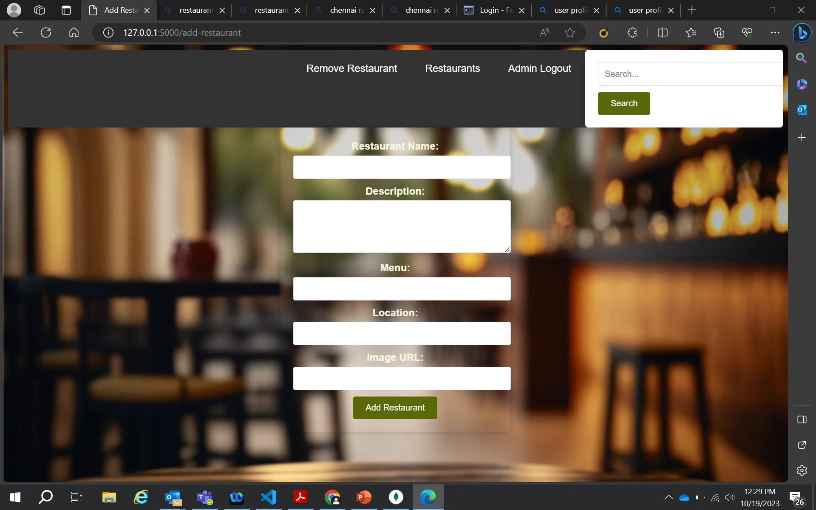
Add Restaurant Page for Admin

Slide 12
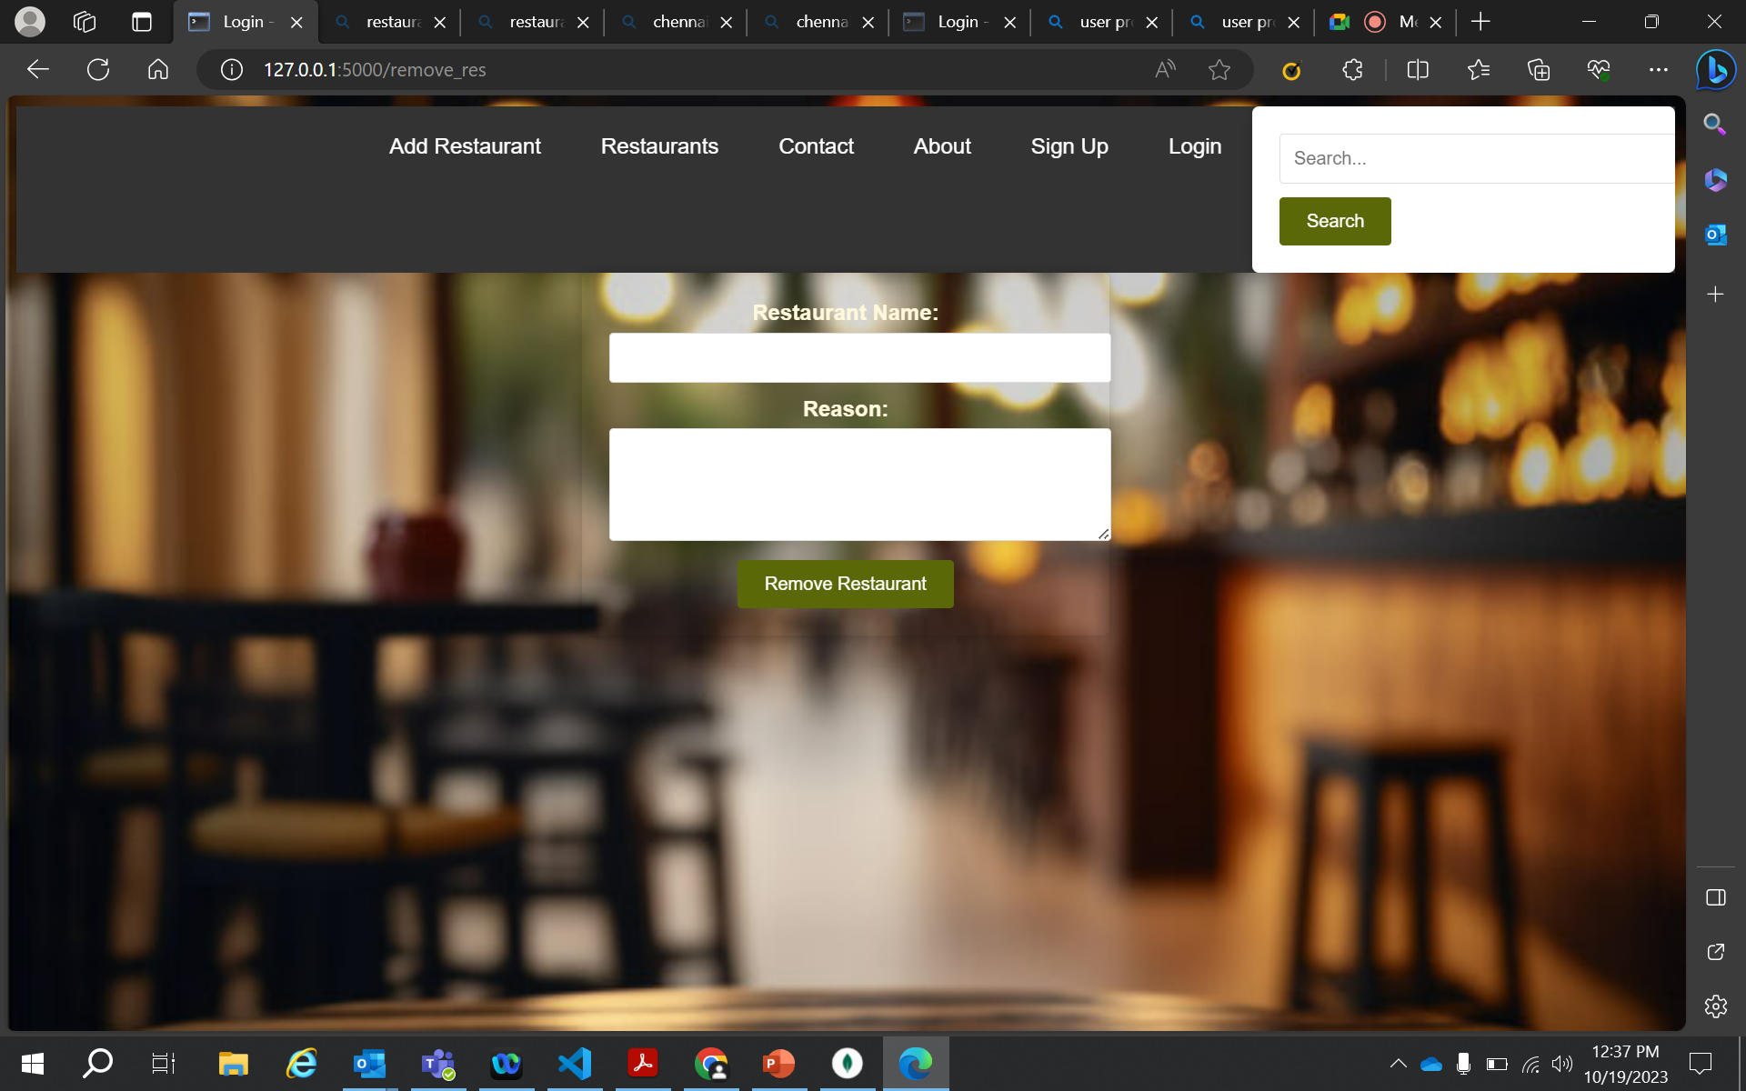

Remove Restaurant Page
Remove
User Page

Slide 13
Challenges faced
Here are some of the challenges you may face while developing the FoodieHub web application, in short:
Designing and implementing a secure and user-friendly authentication system.
Collecting and maintaining a comprehensive database of restaurants.
Providing users with a user-friendly interface for creating and publishing food blogs.
Designing and implementing a recommendation system that can accurately suggest restaurants to users based on their preferences and past interactions.
Creating a user-friendly and efficient admin panel for managing users, reviews, and restaurants.

Slide 14
Future Imrovements
Will add AI based recommendation system.
Will add location based recommendations
Will add email notifications for users

Slide 15
Summary
Thus, FoodieHub is a dynamic web application designed to cater to the needs of food enthusiasts who want to discover new restaurants and share their culinary experiences with others. Whether you are looking for a new restaurant to try, or want to explore different cuisines, FoodieHub offers an extensive range of features to help you achieve this.

Slide 16

THANK YOU
Radhashree Bose
Radhashree.Bose@Chubb.com
FoodieHub

